Slide 1

UniWeb Holding Area
Solution Architecture Proposal
Presented by: Robert Turnbull
Faculté de médecine | Faculty of Medicine
uOttawa.ca
uOttawa.ca

Slide 2
Problem Statement
CV data is stored in multiple different systems. In order to drive adoption of the UniWeb CV system, their data should be brought in from these disparate systems and put into UniWeb. As professors may want to verify the information before it is included, or exclude some types of data, they should have control over the process.

Slide 3
Problem Decomposition
We need to be able to fetch data from other systems regularly.
We need to be able to associate user accounts between these different systems.
We need to be able to robustly write to UniWeb.
We need to be able to transform data from the source data to UniWeb’s format.
We need to allow users to monitor changes and approve them.
We need to be able to authenticate these users to confirm their identity.

Slide 4
Fetching Data
Each data source needs to be analyzed to see if it already has sufficient data exposed.
If not, a new RESTful service will need to be written.
Third-party developers may have to be involved in creating such an interface.

Slide 5
Writing Data
UniWeb’s API is prone to data loss.
They require one to delete a collection to perform an update to any item within it.
Two concurrent requests may end up deleting the entire collection.
Need to add an API layer on top of UniWeb that handles this problem.
Ideally, this is a problem the UniWeb team should solve, but that could take a long time.

Slide 6
User Identity Mapping
Need to know who users are between systems.
Since we are dealing with sensitive information, the mapping must be solid.
This is a problem that will likely occur again: should be solved once and be extensible to additional identifiers (employee ID, Active Directory, one45, MINC, CPSO number, email address, etc.)
Need to add an API that allows look-up of a specific identifier, given another one.

Slide 7
Authentication & Authorization
Need to be able to authenticate a user as being themselves.
Another problem that should be solved once.
Active Directory provides one option, but not all users of all systems have AD accounts.
Also need to control access to our systems, both by users and our services.
Need to build an API to authenticate a user using one or more authentication tools (starting with AD) and provide permission information for that user.

Slide 8
Holding Area
Need to regularly check for changes in the source information (via scheduled tasks).
Need to be able to map and transform that data to UniWeb.
Ideally, this should be easy to change and extend.
Need to be able to present a list of changes to the user.
Need to allow that user to accept change requests.
Need to push those changes into UniWeb once accepted.
Queuing is ideal for this, rather than instant pushes, as it will reduce load on UniWeb.

Slide 9
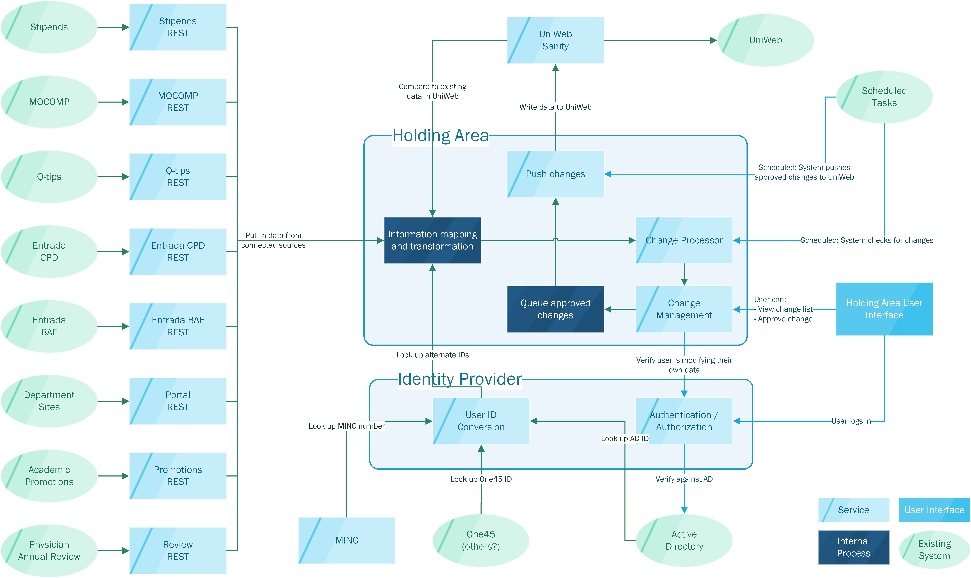

Slide 10
Results
Users are enabled to manage how data flows into UniWeb, minimizing complications and driving adoption.
Flexible holding area for user information management allows easy extension to new sources or targets.
Source data (and UniWeb API) is exposed in a robust and uniform fashion to all other systems, enabling future reuse.
Unified API for identity management and access control, simplifying such tasks in future projects.

Slide 11
Project List
Integration
Stipends
MOCOMP
Q-tips
Entrada CPD / BAF
Department Portals
Academic Promotions
Physician Annual Review
One45 (possibly others)
New Systems
UniWeb Sanity
Holding Area Services
Change Management
Change Detection
Change Pushing
Holding Area UI
User ID Mapping
User Auth
MINC# Storage

Slide 12
Roadmap
UniWeb Sanity
Integration Projects (for stop-gaps)
Stop-gap solutions
User Auth / User ID Mapping
Holding Area UI / Services
Integration Projects (only configuration for #2)
MINC#
Once #5 is done, we can release each integration as it is completed. Once initial analysis is done for each project (to define resources), they can be worked on concurrently.

